Slide 1
Laws & Convention Cards
A Practical Guide for Beginners

Slide 2
What’s the Point?
Convention cards encourage transparent agreements
As unusual events occur, a normal result becomes harder to achieve
Laws work to restore equity after an irregularity has occurred

Slide 3
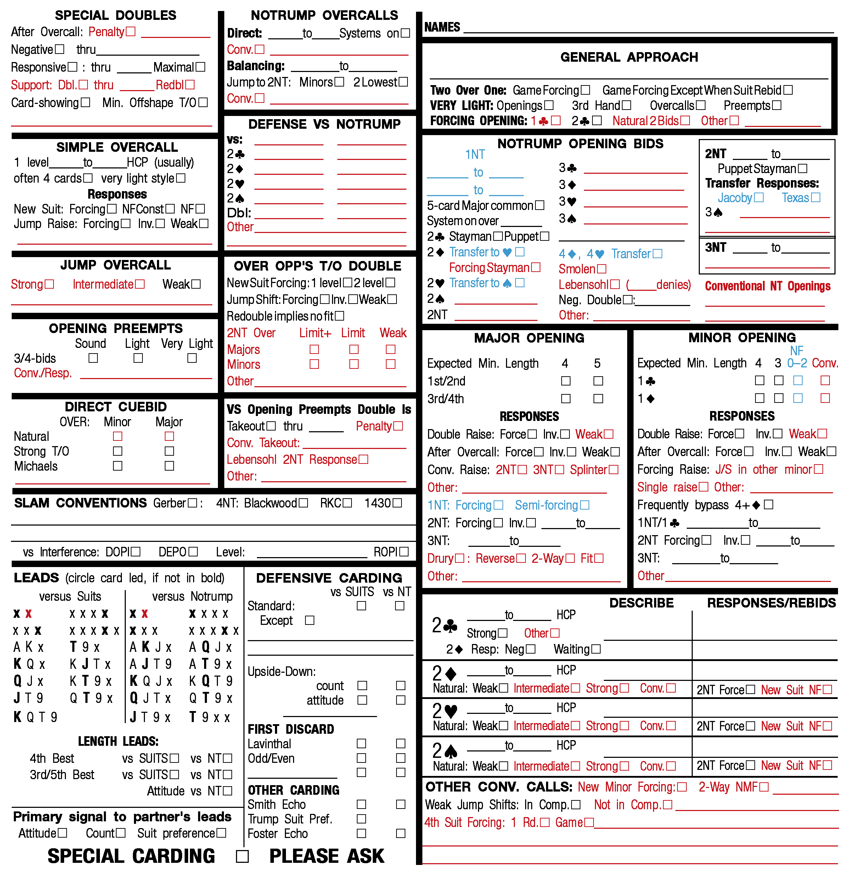
Bold lines divide card into sections w/ headings
Check boxes as applicable, fill in other details on lines
Bold cards in “Leads” are assumed unless indicated otherwise

Slide 4
Key Ideas: Convention Cards
A SUMMARY of Methods
Blue = Announce, Red = Alert
Obstructive Bidding (Left) Constructive Bidding (Right)
Bottom Right “Other” Section – Write things otherwise unsure where to place here
Do not fill in boxes lacking an agreement

Slide 5
Common Irregularities
Revoke
Lead out of Turn
Insufficient Bid
Bid/Pass Out of Turn
Hesitations (UI)

Slide 6
Revoke
Established when offender or partner makes another play/claim
Revoke must be corrected if possible before being established (major penalty card)
Transfer 1 trick to non-offending side (+1 subsequent if revoke trick was won)
Cannot automatically check the quitted cards for a revoke (call director)

Slide 7
Lead out of Turn
Opening Lead
Accepted (declarer may choose to become dummy – consider faced cards)
Rejected (lead becomes major penalty card, otherwise def. req/prohib. lead, card returned to hand)
Lead Mid-Play
May be accepted by non-offending side, corrected otherwise
Notes:
Show example as bid in diagram

Slide 8
Insufficient Bid
May be accepted by LHO
The auction continues normally after a comparable call/lowest sufficient bid
Cannot be replaced by X/XX (unless comparable)
Notes:
Give example by overcalling 2N

Slide 9
Pass/Bid Out of Turn
RHO: Must pass
P / LHO, no previous bid: Any legal call (not comparable -> p passes 1st opportunity)
RHO: Repeat if RHO passes, otherwise make any call (if not comparable, p passes at next opportunity)
P / LHO No previous bid: Any legal call (not comparable -> p passes 1st opportunity)
Notes:
Show example w/ N/W passing, then South bidding out of rotation

Slide 10
Hesitations
(a) A player may not choose a call or play that is demonstrably suggested over another by unauthorized information if the other call or play is a logical alternative.
(b) A logical alternative is an action that a significant proportion of the class of players in question, using the methods of the partnership, would seriously consider, and some might select

